Slide 1
Starting with OpenGL
Muhammad Tasnim Mohiuddin
Lecturer, CSE, UIU

Slide 2
Setting up OpenGL for visual studio 12
Copy & Paste :
glut32.dll to C:\Windows\system,
glut32.lib to Program Files\Microsoft Visual Studio 11.0\VC\lib, and
glut.h to Program Files\Microsoft Visual Studio 11.0\VC\include\GL
If there is no GL folder create one

Slide 3
Beginning
Open Visual Studio 12
File >> New >> New Project

Slide 4
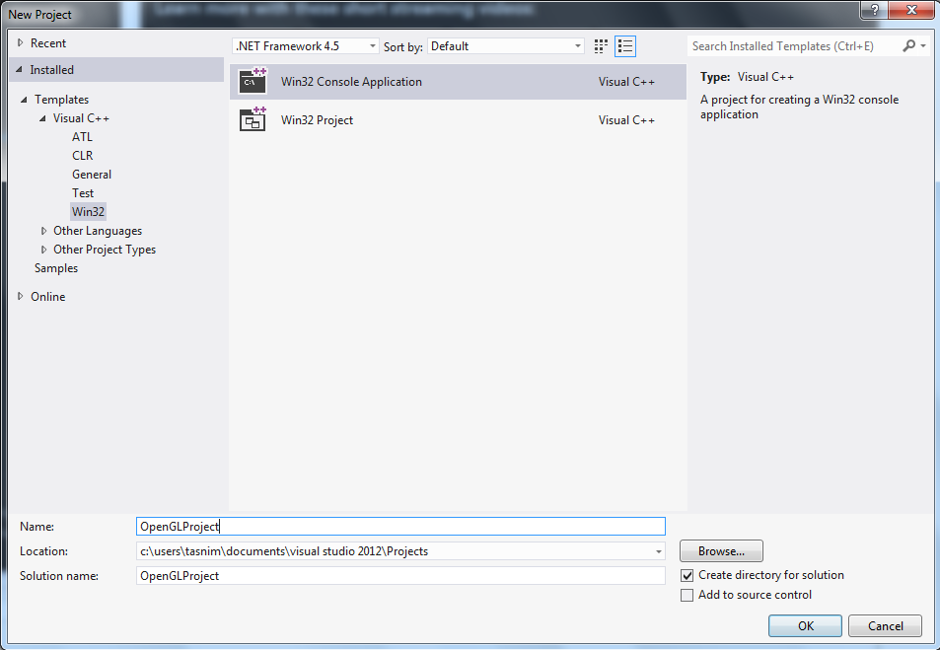

Slide 5
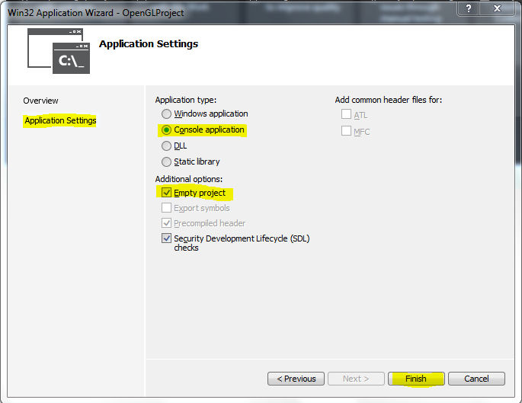

Slide 6
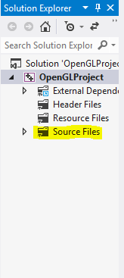
Your project is empty. Add new item (C++ file) to source file.

Slide 7
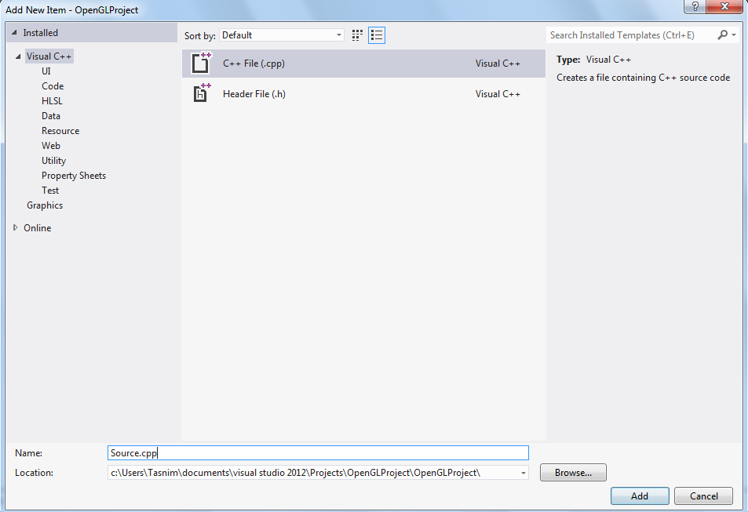

Slide 8
Start OpenGL Coding
Follow me

Slide 9
Now, what to do ?
Add some models
Add Camera
Add Projection

Slide 10
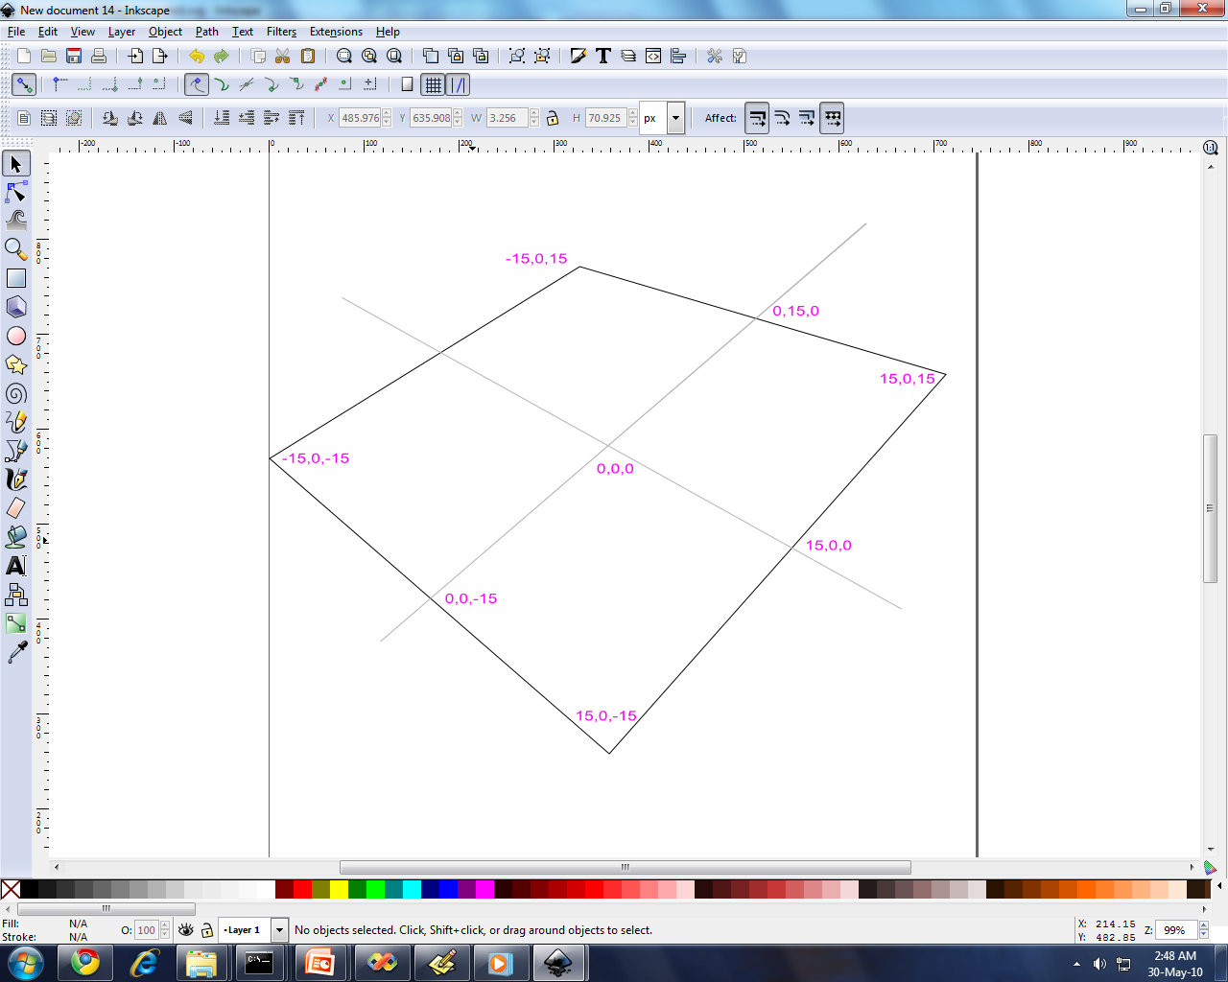
Draw a story board

Slide 11
What about viewing ?
What do you find ?
Nothing
What's the problem ?
No camera or view!!
No projection !!

Slide 12
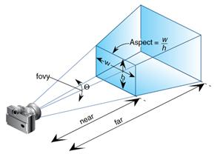
Perspective Projection

